Slide 1
Project 3: Networks and Social Network Analysis
CUNY LaGuardia Community College

Slide 2
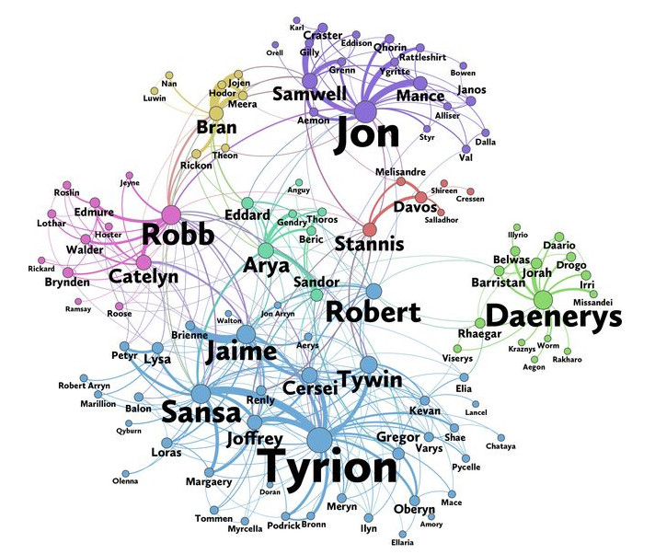

Social Network Analysis Project

Slide 3
Step 1 - Download Dataset from Kaggle
Create a Kaggle Account
Navigate to the Dataset Page
Download the Dataset
Unzip the File - Windows
Unzip the File - Mac
Go to the Kaggle website and sign up for an account if you don’t already have one.
Open the dataset link in your browser: GOT Network Dataset. Log into your Kaggle Account
On the dataset page, click the Download button. Kaggle will download a .zip file named archive.zip.
Right click archive.zip. Select Extract Here…,. Windows will create a folder with the extracted files in the current location.
Go to the Downloads folder and locate the .zip file (e.g., archive.zip).Simply double-click on the file to unzip it.
1
2
3
4A
4B

Slide 4
Step 2 - Set Up Google Colab
To begin working with the dataset, open the provided Google Colab link: Google Colab Notebook.
Once the notebook opens, locate the book1.csv - book5.csv files on your computer. This file might be in your Downloads folder or in a folder named archive, depending on where you saved or extracted it. In the Colab notebook, look for the Files sidebar on the left. If the sidebar isn’t visible, click on the folder icon to expand it. Then, drag and drop the book.csv files into the Files section. This action uploads the files directly to your Colab environment, making it accessible for use in the notebook.

Slide 5
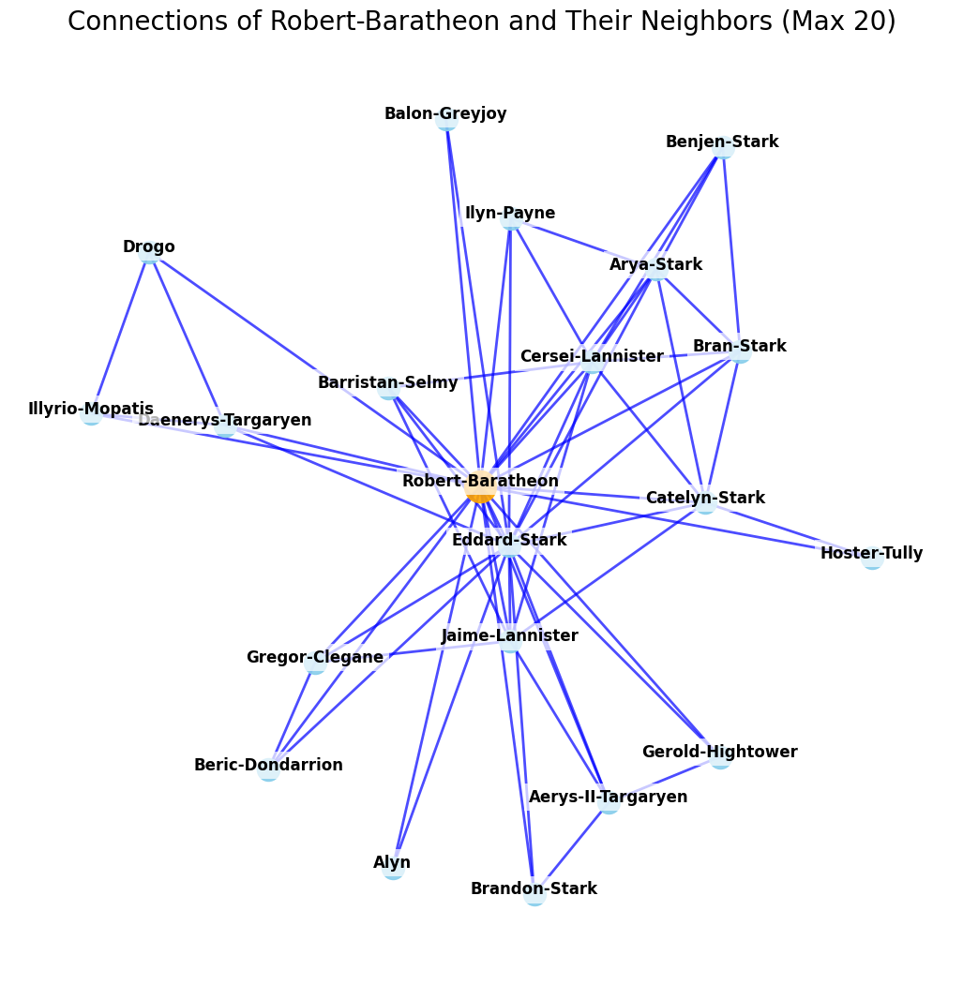
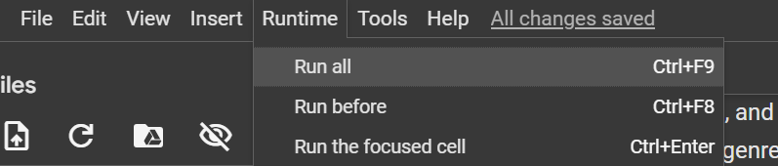
Step 3 - Run the Notebook
Run all cells in the notebook and save the your favorites of the outputted Network Visualizations as screenshots.

Slide 6
Step 4 - Experiment with Centrality
Who is the most important character in the world of Game of Thrones? Is it Jon Snow, Tyrion, Daenerys, or someone else entirely? To answer this, we use network science, which provides many metrics to evaluate the importance of a node in a network. Each metric highlights a different aspect of importance, so there is no single "correct" way to measure it.
By default, your notebook will measure importance using degree centrality, which looks at how many connections (neighbors) a node has.
After analyzing the results of this, try using other measurements of importance, such as betweenness centrality, which identifies characters acting as bridges between others, and closeness centrality, which finds characters close to all others in terms of graph distance. You can easily experiment by changing the line:
df_book5 = df_book5.sort_values(by="Degree Centrality", ascending=False).head(10) # Top 10
to use "Betweenness Centrality" or "Closeness Centrality" instead. This will rank the characters based on those metrics, giving new insights into their importance!

Slide 7
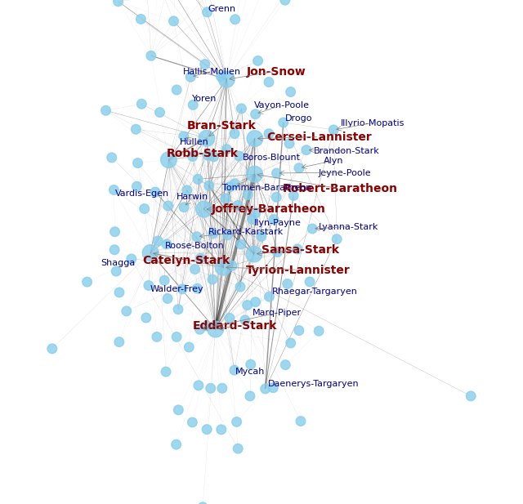
Step 5 - Visualizing the Network
This visualization highlights:
Top 10 most central characters with larger, red labels.
A random sample of 20 moderately connected characters for additional context, displayed with smaller, blue labels.
Edges scaled in width based on the strength of connections
Experiment with the code to learn more!

Slide 8
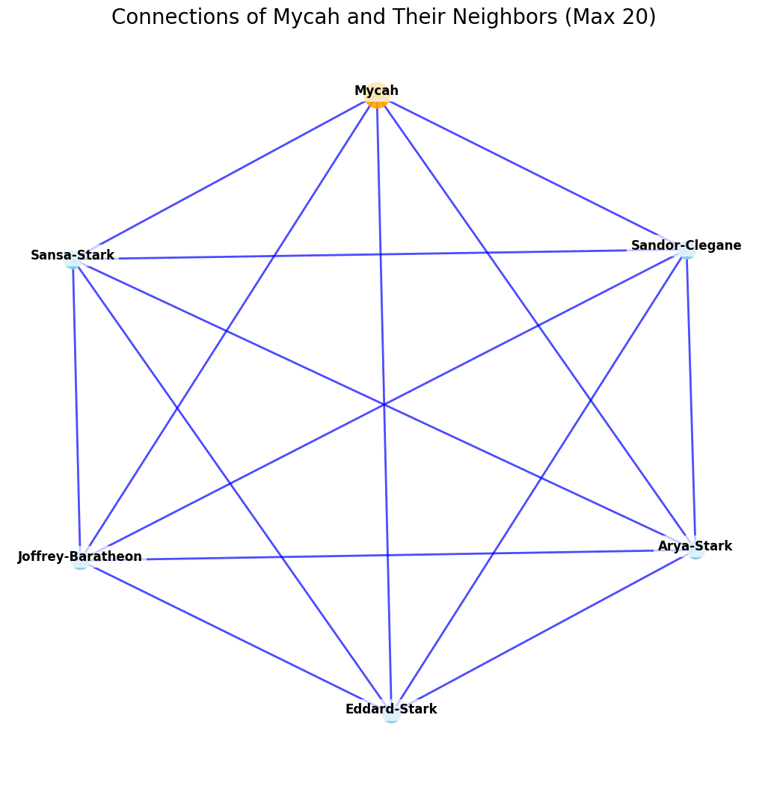
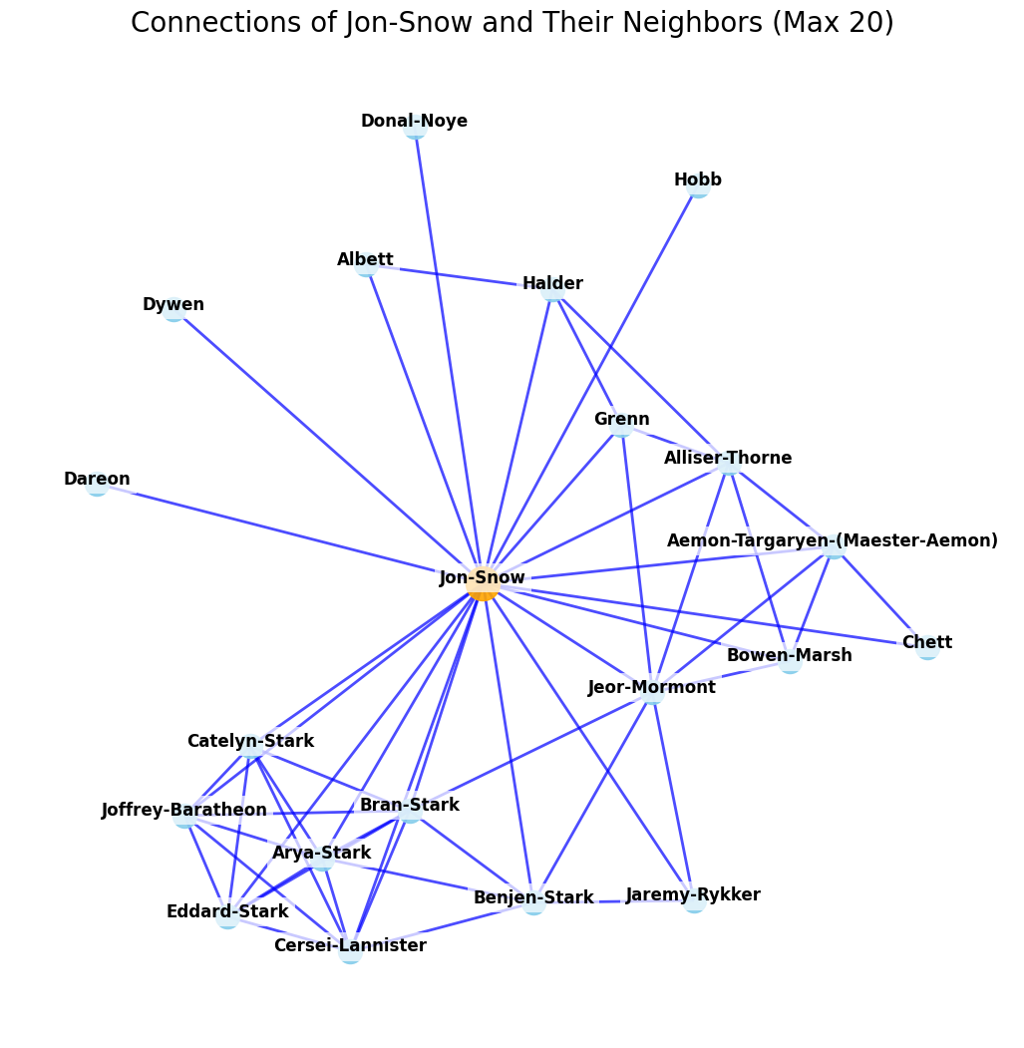
Step 6 - Analyze a Character’s Network
Analyze the immediate network of a single focus character to explore their direct connections (degree), the cohesion of their neighbors (clustering), and whether they link unconnected groups (bridging role). Experiment by comparing different characters to uncover variations in local influence and network structure.

Slide 9
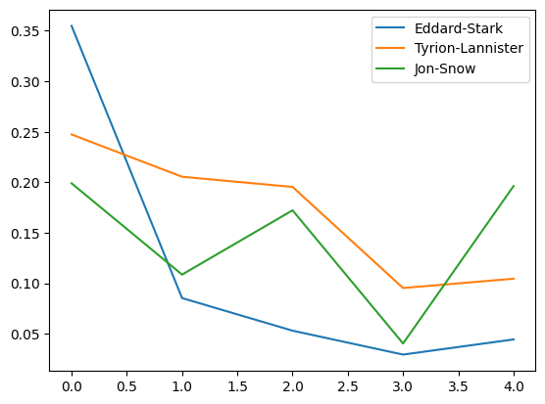
Step 7: Graph Centrality over Time
Visualize the evolution of degree centrality for key characters over time.
Experiments to Try:
Track Different Characters Across Books:
Use a Different Centrality Measure:

Slide 10
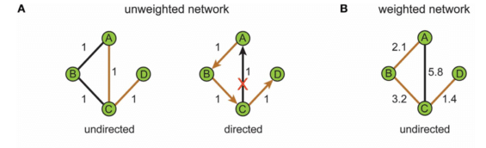
Step 8: Navigate Connections Between Characters
In this activity, you will explore both the unweighted and weighted shortest paths between two characters in the network. Examine how two individuals are connected, which bridges link them, and how interaction frequency (weight) impacts the paths.

Slide 11
Step 9: Case Study
Final Task: Compare Two Characters
Who is More Important?
Analyze the centrality measures (degree, closeness, betweenness) for both characters. Which character has greater influence within the network?
Are They Meaningfully Related?
Examine their personal graphs to understand their immediate connections and roles in their local networks.
Use shortest path analysis (both weighted and unweighted) to determine how directly or strongly they are connected.
Back It Up with Evidence:
Use specific findings from your analysis (e.g., connectivity, clustering, path distances) to justify your conclusion about which character is more important and how they are related.

Slide 12
Social Network Analysis
Congratulations on completing the Game of Thrones Network Analysis! You’ve explored the social network of the characters, analyzed measures like centrality and clustering, and compared weighted and unweighted shortest paths. Along the way, you uncovered character importance and visualized personal networks.
To take your analysis further, consider applying these techniques across the entire series, comparing how character importance evolves over time. You could also investigate whether certain clusters or relationships are consistent across all books or if they shift significantly. Additionally, explore how removing key characters (e.g., bridges or hubs) affects the overall network structure, revealing their impact on the connectivity of the story.

